Slide 1
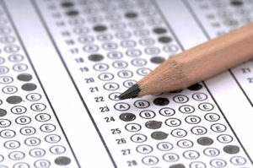
Deep Analysis and Prediction of the Effects of Various Factors on the Performance of Students on Examinations
By: arun agarwal

Slide 2





Topic and Objective
Topic: Effects of factors such as parental level of education, gender, race, taking a test preparation course, and having or not having lunch on a student’s performance on examinations
Objective: to understand which aspects have the largest impact on test outcomes as well as what are the best ways to improve student scores for the future
By using various supervised learning techniques including linear regression and logistic regression, I will try to answer:
Does the parent's level of education impact the success of the student?
Can one's race serve as a benefit or hindrance (or neither) to their performance on examinations?
Will taking a test preparation score have a positive impact on student's examination scores?
Is there substantial differences seen between males and females regarding examination performance?
Can we predict student performance by creating models with the provided dataset?
Are their high correlations between any of the features/target variables?

Slide 3
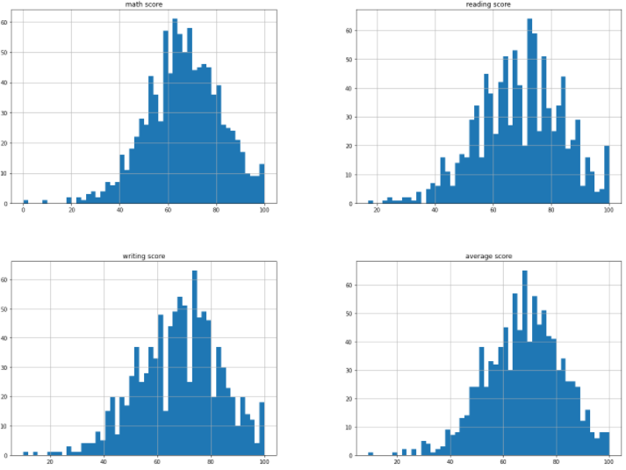
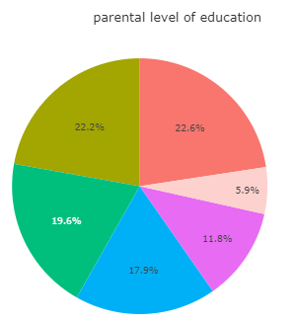
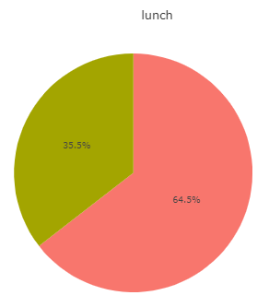
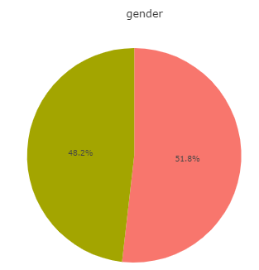
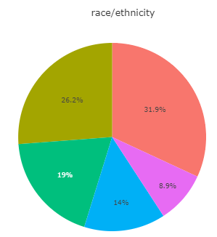
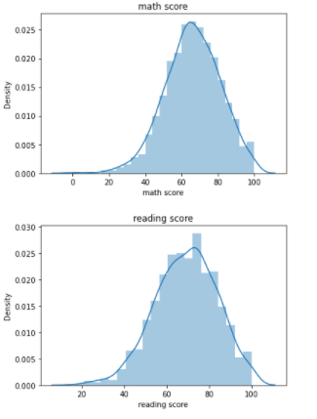
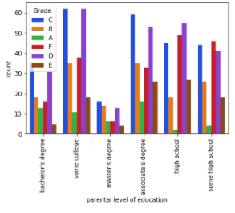

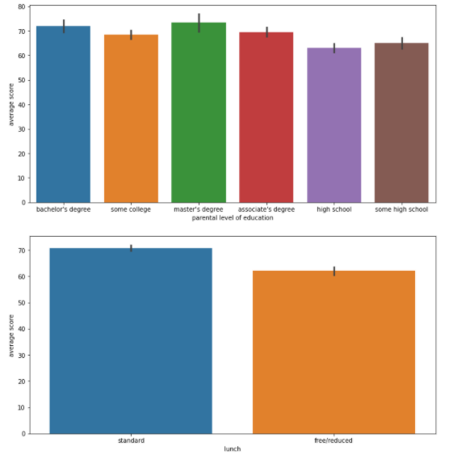
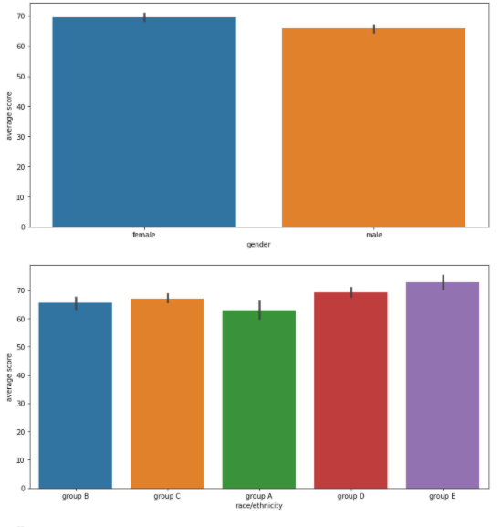
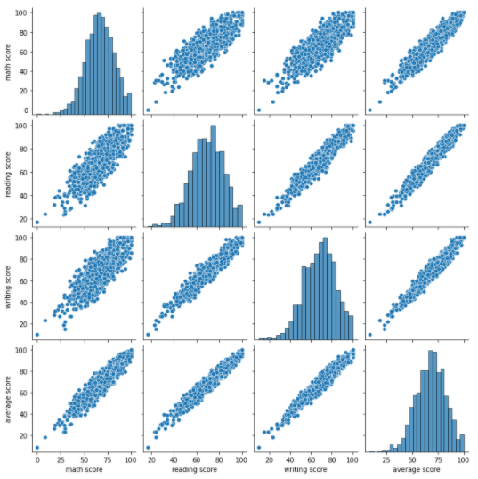
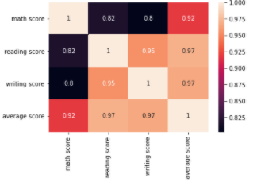
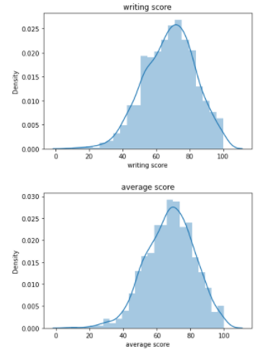
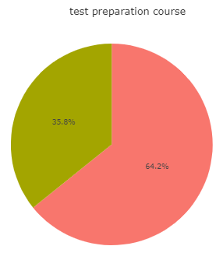
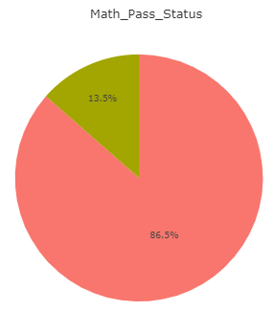
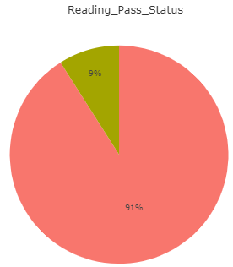
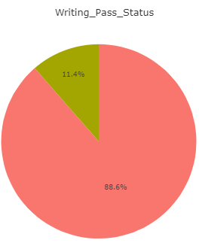
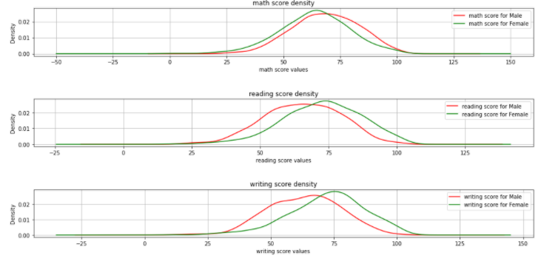
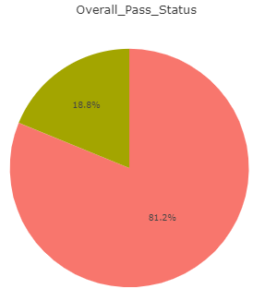
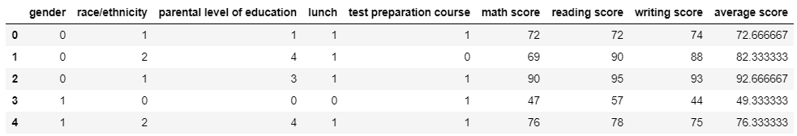
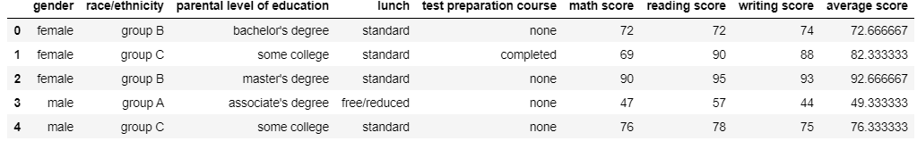
The Data
Dataset provided by Royce Kimmons
Data for 1000 students
Includes both features—gender, race/ethnicity, parental level of education, test preparation course, lunch—and dependent variables/targets—scores in reading, writing, and mathematics
No missing values
While outliers did not exist, none would have been removed anyways due to size of dataset
Before Label Encoding: Categorical features: 5; Numerical Features: 4

Slide 4







The Models
After label encoding and splitting the dataset into training and testing sets (80-20 ratio), I built linear and ridge regression models to see how well the features could predict student performance:
Logistic Regression Model still being worked on!

Slide 5
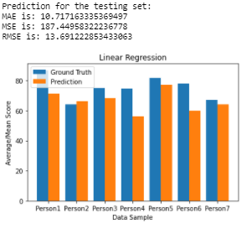
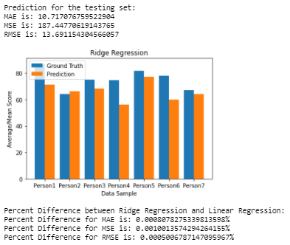
The Results
A large amount of information was able to be collected just from the exploratory data analysis (plots, figures, etc.)
For the Linear and Ridge Regression Models:
The plots demonstrate the learned model does well to generalize on the testing set (student performance on examinations is correlated with and can be predicted from gender, ethnicity, parental level of education, test preparation course, and lunch)
Since the percent difference values between linear and ridge regression are so small, one can say that they perform almost identically
Logistic Regression model demonstrates that whether someone had lunch before an examination or not can be predicted based on their scores (and will be added upon to demonstrate a correlation between gender and scores)

Slide 6
Resources/References
https://www.kaggle.com/spscientist/students-performance-in-exams/tasks
http://roycekimmons.com/tools/generated_data/exams
https://www.kaggle.com/ritikpnayak/regression-model-1-the-best-fit-line-with-r2-0-9
https://www.kaggle.com/josephchan524/studentperformanceregressor-rmse-12-26-r2-0-26
https://www.globalcitizen.org/en/content/9-facts-about-education/
https://www.habitatbroward.org/benefits-of education/#:~:text=It%20helps%20people%20become%20better,rights%2C%20laws%2C%20and%20regulations.
https://files.eric.ed.gov/fulltext/EJ1151836.pdf
https://peer.asee.org/regression-models-for-predicting-student-academic-performance-in-an-engineering-dynamics-course.pdf
https://www.kdnuggets.com/2020/01/beginners-guide-nearest-neighbors-r.html
https://scikit-learn.org/stable/modules/generated/sklearn.neighbors.NeighborhoodComponentsAnalysis.html
https://towardsdatascience.com/logistic-regression-using-python-sklearn-numpy-mnist-handwriting-recognition-matplotlib-a6b31e2b166a

